Slide 1
Computational Cognitive Science
Lecture 12: Causality 3
Guest lecturer: Tadeg Quillien
School of Informatics, University of Edinburgh

Slide 2
Last week: causal inference
How can we discover the general causal relations among all these things?
Wood
Oxygen
Spark
Fire

Slide 3
Last week: causal inference
The goal is to discover the correct causal model:
Wood
Oxygen
Spark
Fire

Slide 4
This week: ‘actual causation’
Assume that we already know the causal model below
Suppose a friend asks you why a fire happened. What do you tell them?
Wood
Oxygen
Spark
Fire

Slide 5
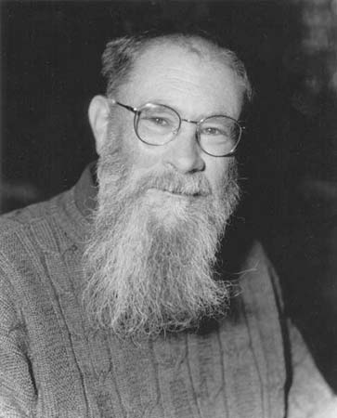
Counterfactual theory of causation (e.g. David Lewis)
C is a cause of E if:
If C had not happened, E would not have happened either
Without the spark, the fire would not have started -> The spark caused the fire

Slide 6
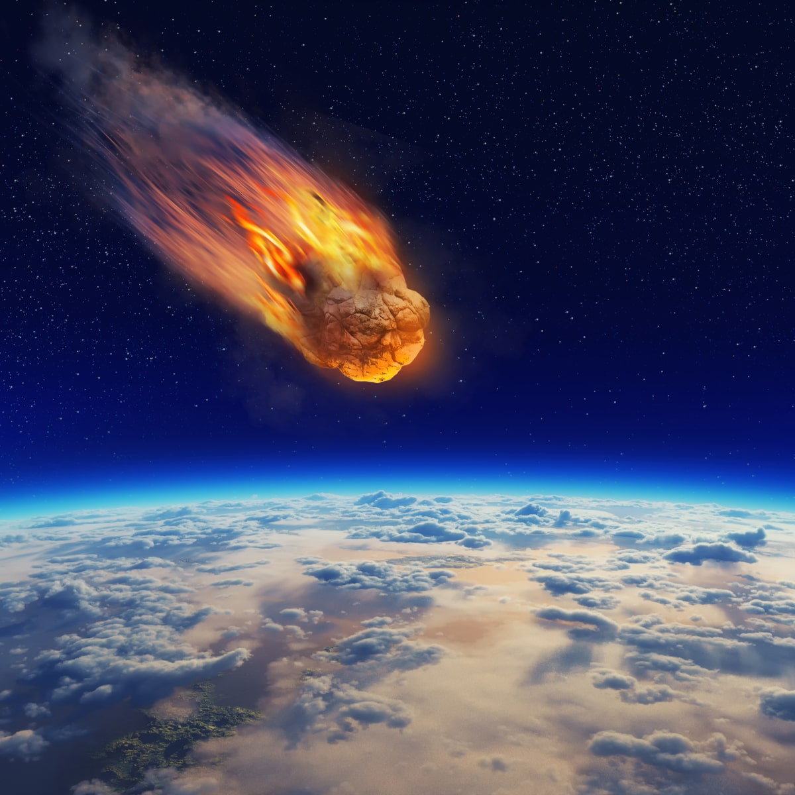
Problems with the counterfactual approach
If a meteor had struck Edinburgh this morning, I would not be giving this lecture
-> I am giving this lecture because no meteor struck Edinburgh this morning
If there had been no oxygen in the air, the fire would not have started
-> The fire started because there was oxygen in the air

Slide 7
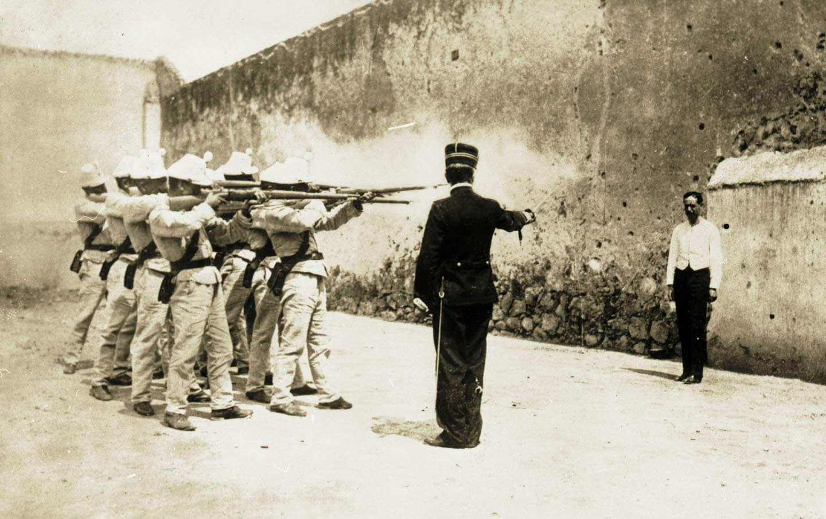
Problems with the counterfactual approach
The prisoner would be dead, even if soldier A had not shot
The prisoner would be dead, even if soldier B had not shot
-> None of the soldiers caused the prisoner’s death!

Slide 8
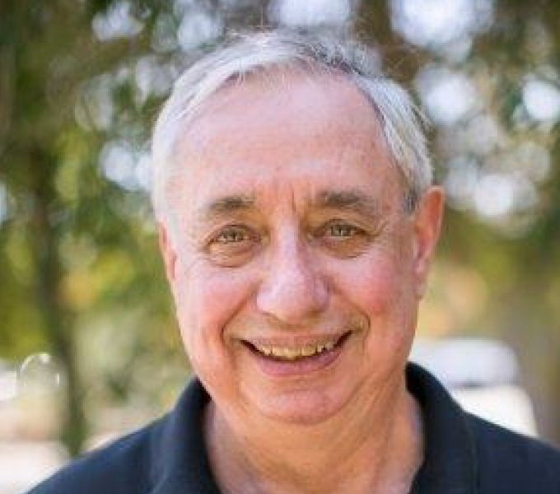
Saving the counterfactual theory: “invariant” counterfactual dependence (Jim Woodward)
To be a cause of E, the link between C and E must be invariant
I.e. C would have led to E even if the background conditions had been different
The absence of meteor is not an invariant cause of my giving this lecture

Slide 9
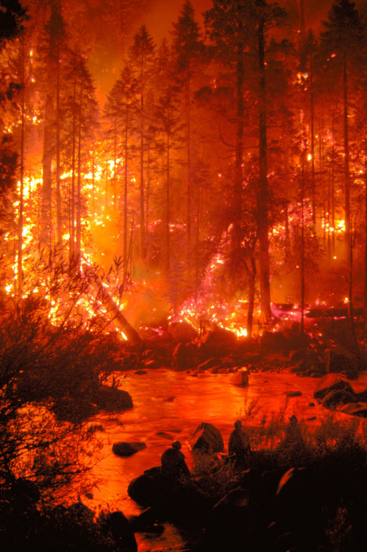
Saving the counterfactual theory: “invariant” counterfactual dependence (Jim Woodward)
Oxygen is not an invariant cause of the fire
Soldier A shooting is an invariant cause of the prisoner’s death
Is there experimental evidence for the role of invariance?

Slide 10
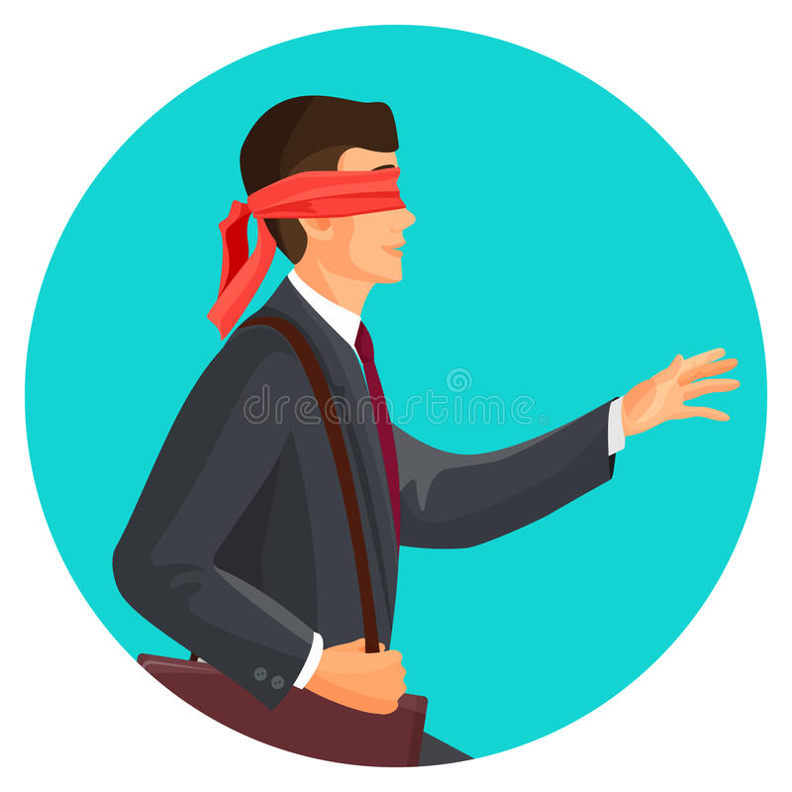
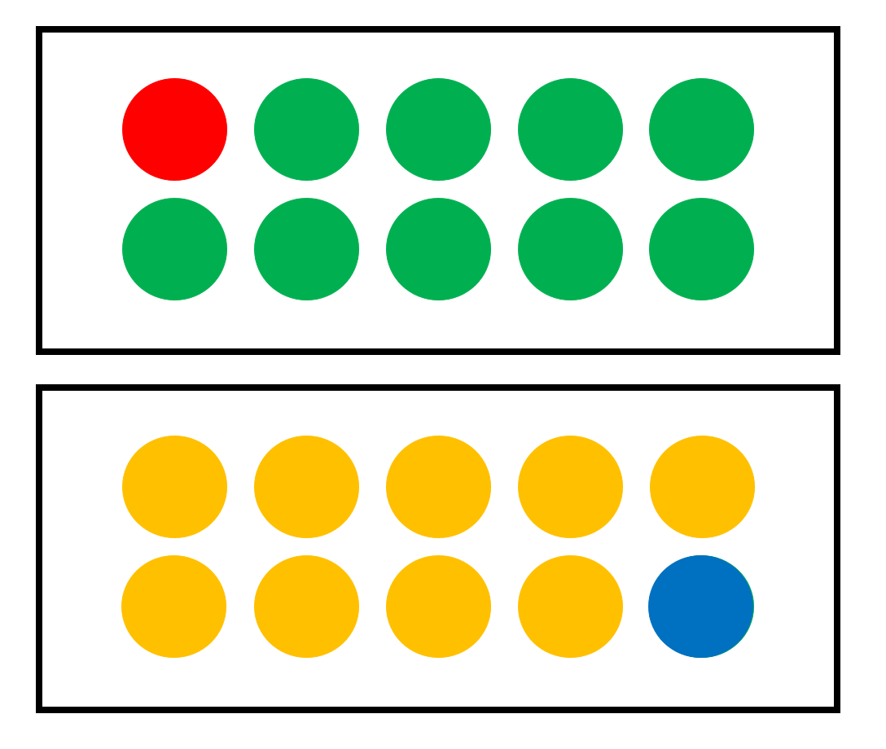
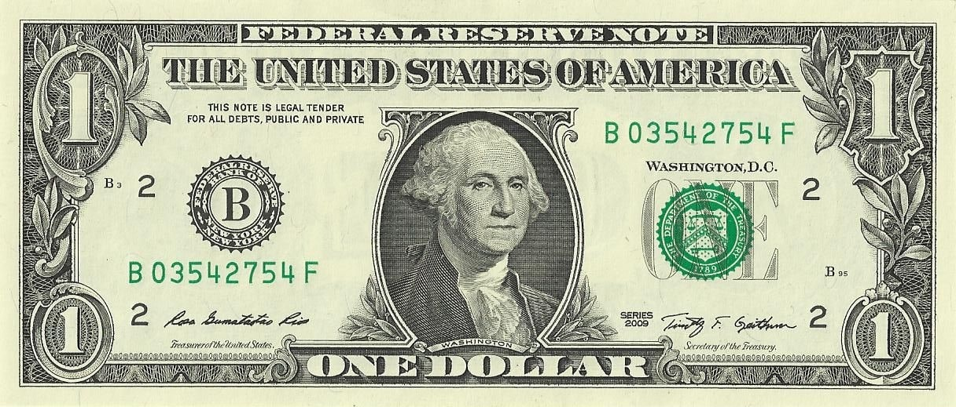
You win a dollar if and only if you get a green ball from the top box AND a blue ball from the bottom box.
Did Joe win a dollar because he drew a green ball, or because he drew a blue ball?
(Morris et al., 2019, PLoS One)
&

Slide 11
“Invariance” is still a vague philosophical notion
What computations actually underlie our sense of causation?

Slide 12
Counterfactual effect size model (Quillien, 2020)
To judge whether C caused E, people:
‘sample’ counterfactuals from the set of possible outcomes
compute the correlation between C and E across these counterfactuals

Slide 13
Sample counterfactuals by mental simulation
Ball from top box | Ball from bottom box | Outcome
&

Slide 14
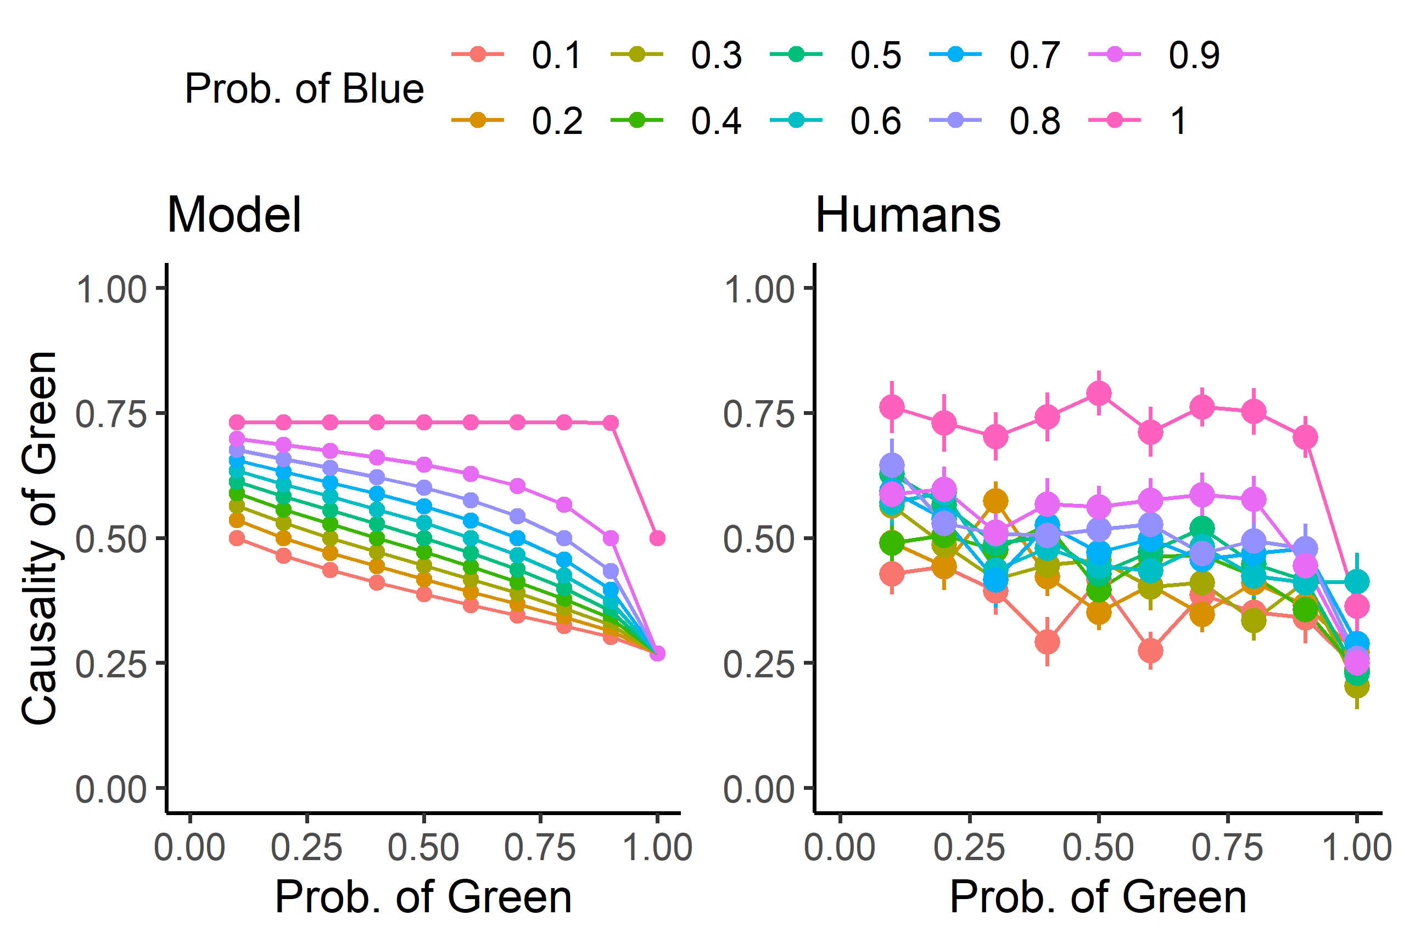
Counterfactual effect size model
r = .89
Data from Exp 1 in Morris et al., 2019, PLoS One

Slide 15
Ball from top box | Ball from bottom box | Outcome
OR

Slide 16
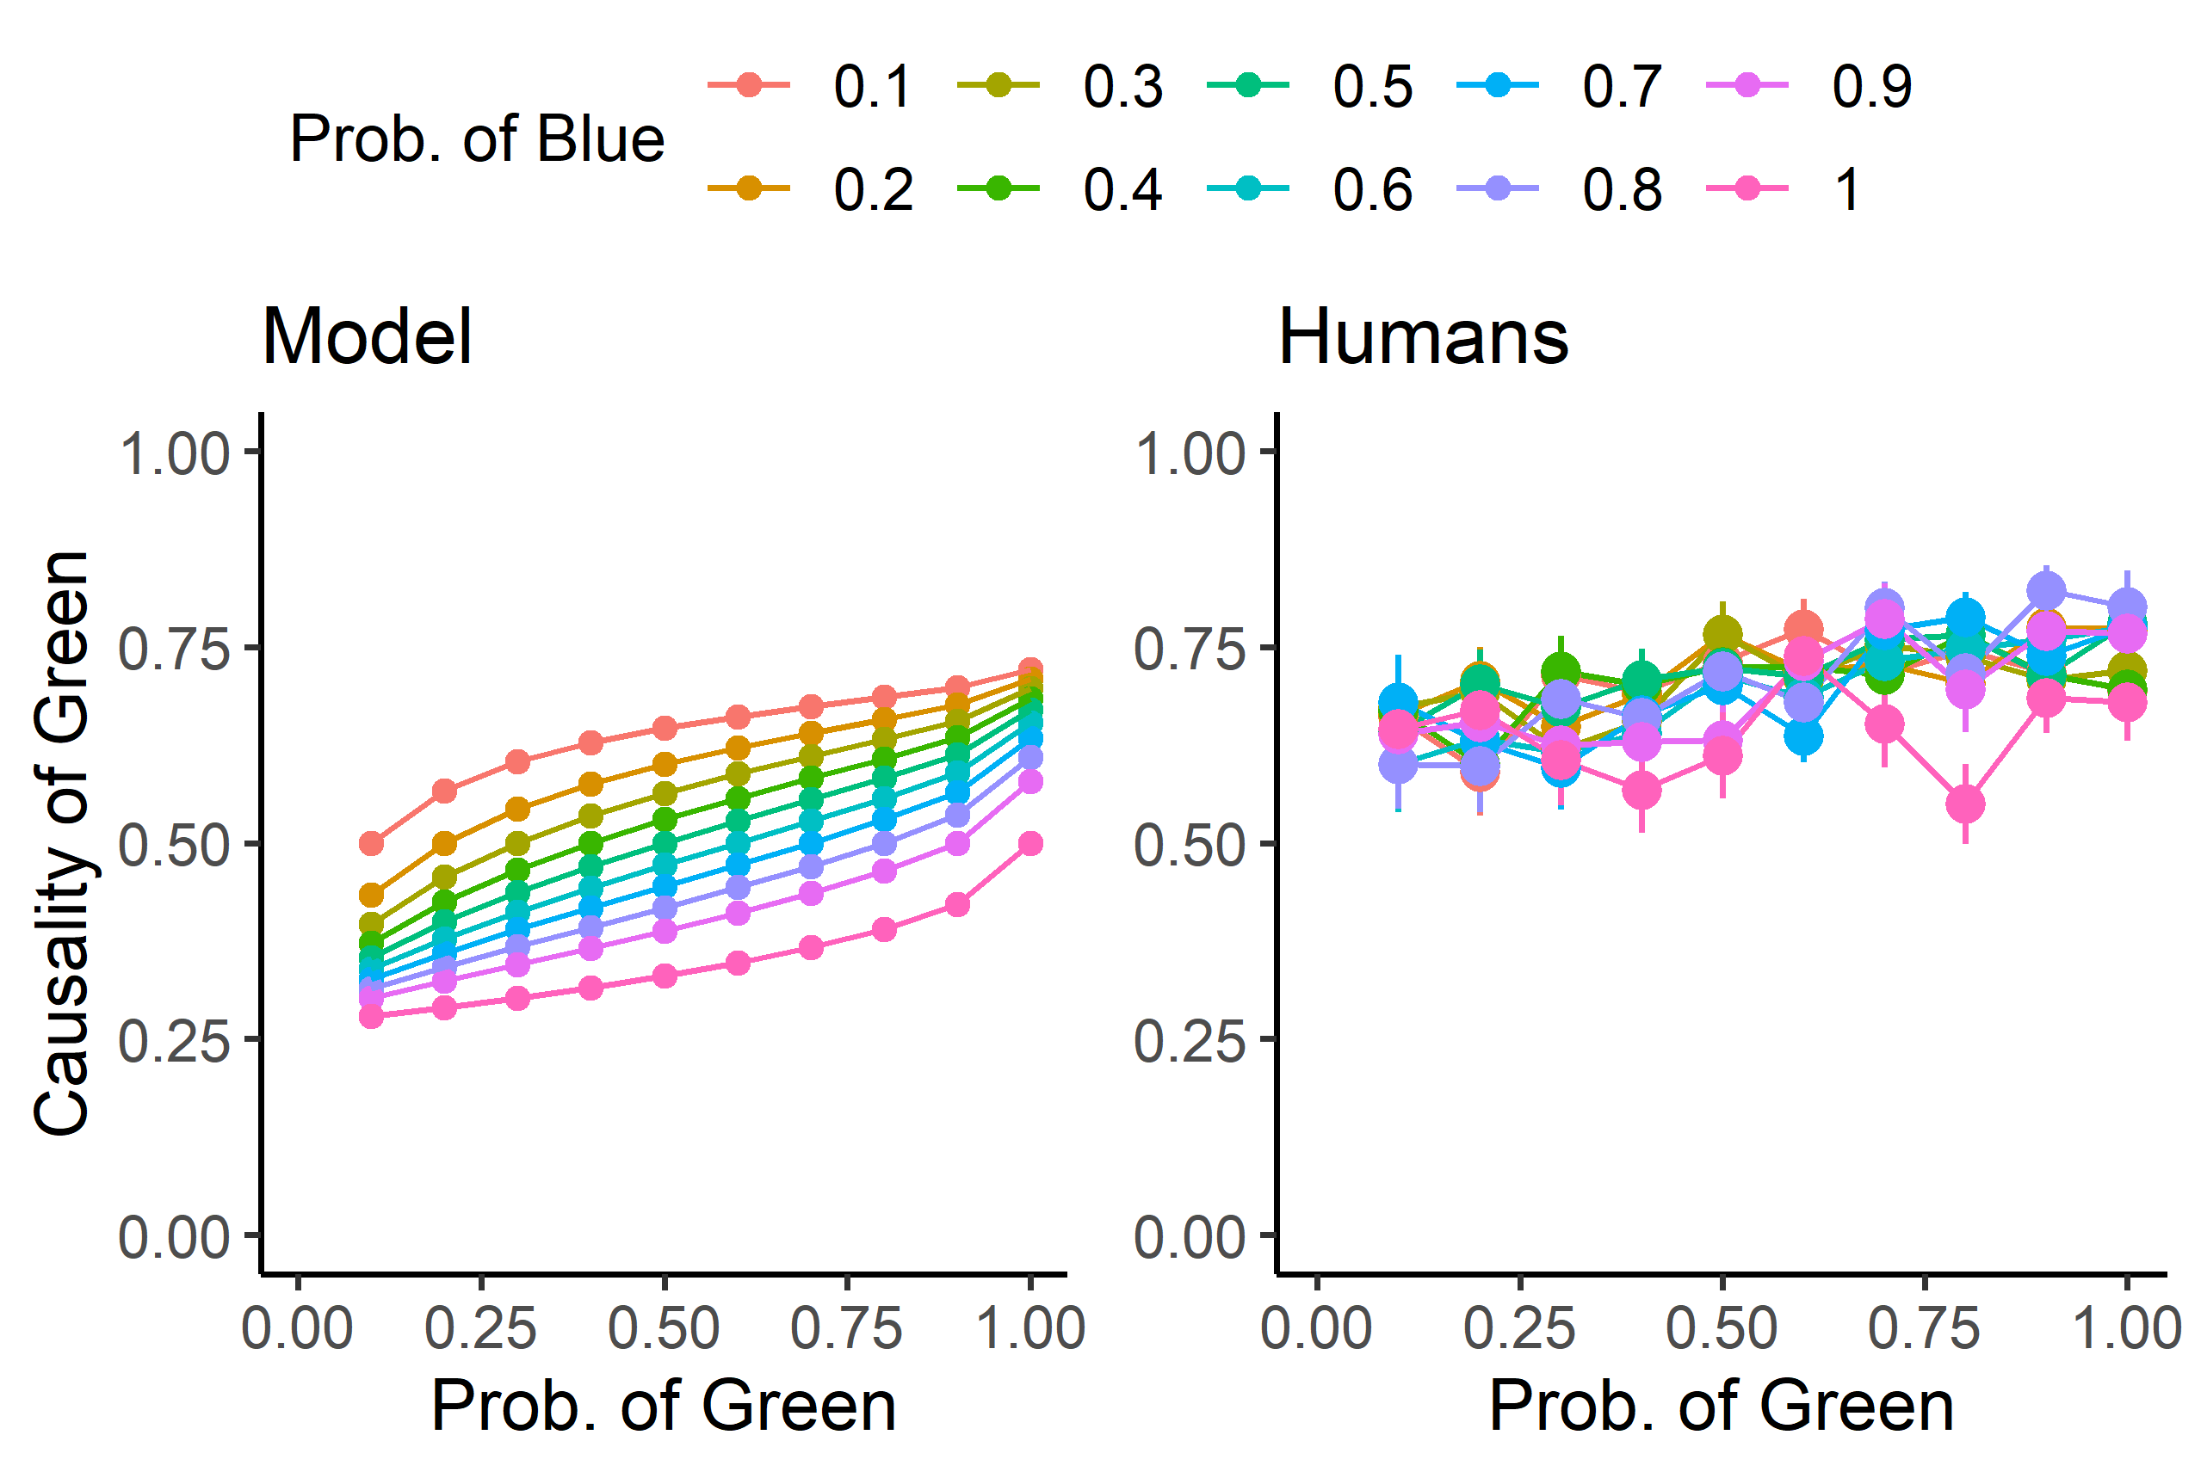
OR
Structure
Quillien, 2020
Data from Morris et al., 2019

Slide 17
The definition of “correlation” used by the model is slightly different than the ordinary statistical notion
(Winning the prize is correlated with drawing a green ball, but does not cause it)
See optional online readings for more details on the “interventionist” definition of correlation used by the model

Slide 18
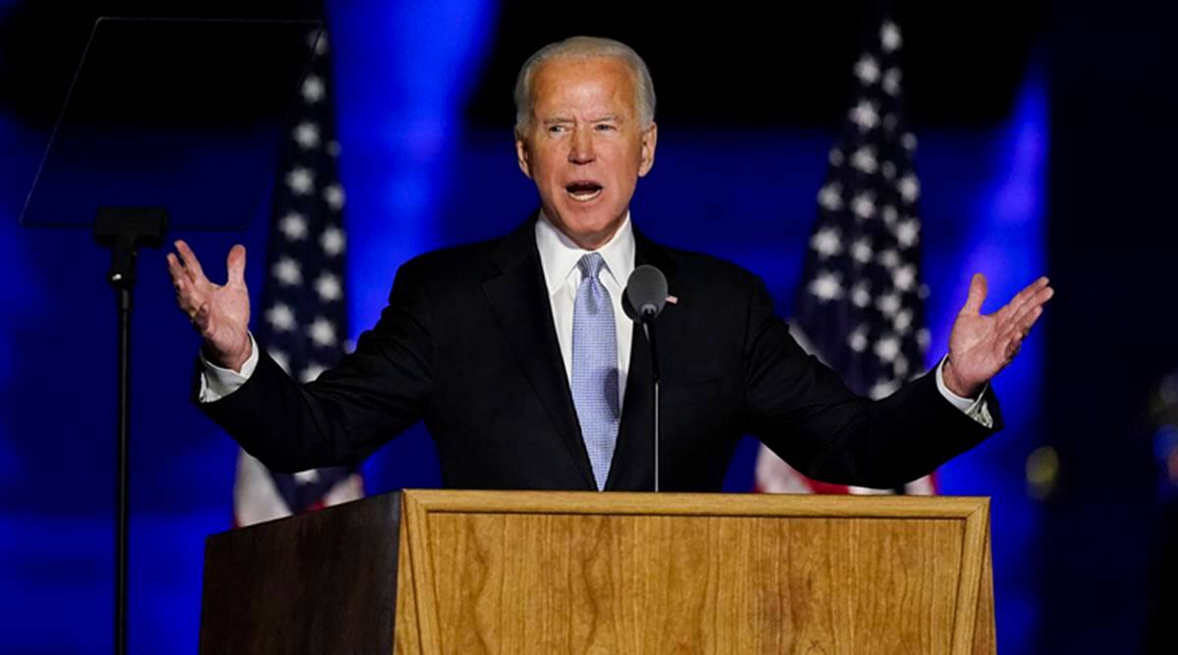
Testing the model with a real-world example
Which state caused Biden to win the election?

Slide 19
Average human judgments N=207
Quillien & Barlev, under review

Slide 20
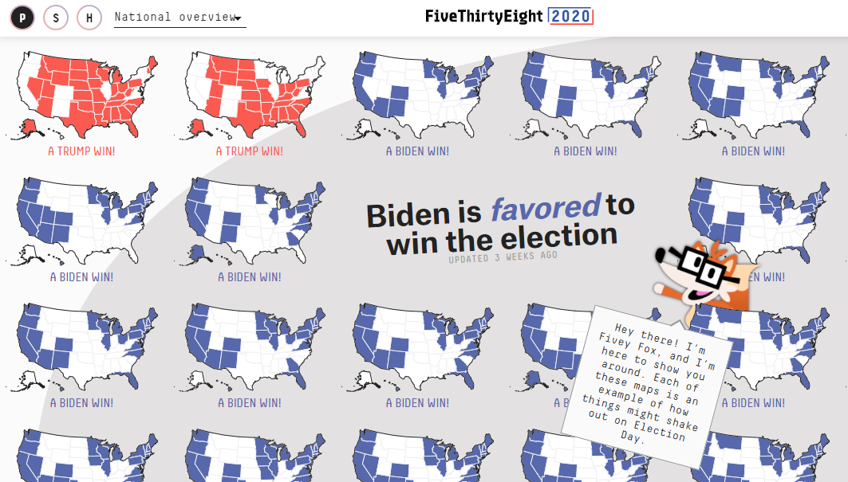
Model
To compute the “causal strength” of the state of New York:
Take the correlation, across all simulations, between “Biden wins in New York”, and “Biden wins the presidency”

Slide 21
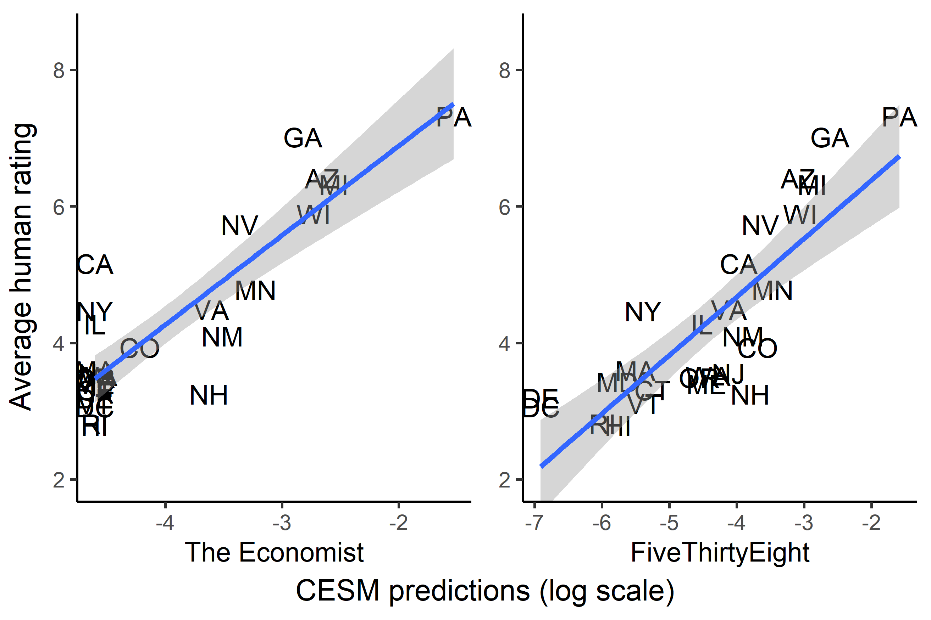
Quillien & Barlev, under review

Slide 22
Morality and actual causation (Hitchcock & Knobe, 2009)
Who caused the collision?
Counterfactuals are biased toward situations where people don’t violate norms.
Across counterfactuals, the behavior of the car is more highly correlated with the collision

Slide 23
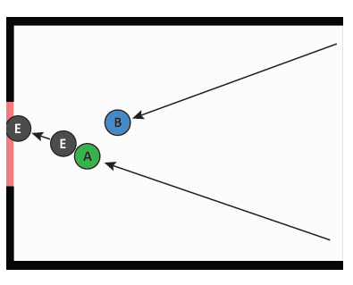
Outstanding mysteries
Did the green ball cause the black ball to go through the gate?
Did the blue ball cause the black ball to go through the gate?
Across counterfactuals, there is a correlation between the blue ball’s presence and the black ball going through the gate -> incorrect causal attribution
(this is called a case of “causal pre-emption”)

Slide 24
Ongoing research questions
How exactly do people sample counterfactuals?
Does the way that judges attribute causal responsibility match our intuitive notion of cause?
Does our intuitive notion of actual cause shape the way we use other concepts?
etc

Slide 25
References
Lewis, D. (1973). Causation. The journal of philosophy, 70(17), 556-567.
Woodward, J. (2003). Making things happen: A theory of causal explanation. Oxford university press.
Hitchcock, C., & Knobe, J. (2009). Cause and norm. The Journal of Philosophy, 106(11), 587-612.
Quillien, T. (2020). When do we think that X caused Y?. Cognition, 205, 104410.
Quillien, T., & Barlev, M. (under review). Causal judgment in the wild: evidence from the 2020 US presidential election.

