Slide 1
OOI Cyberinfrastructure
Overview of the Governance Architecture
09 Jan 2014

Slide 2
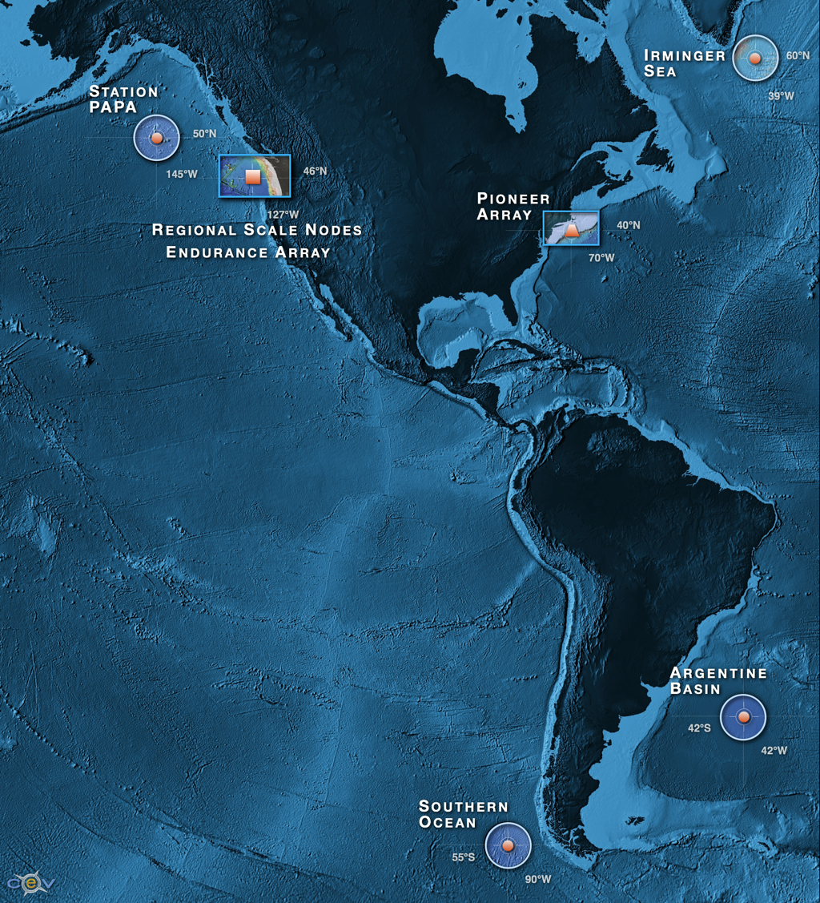
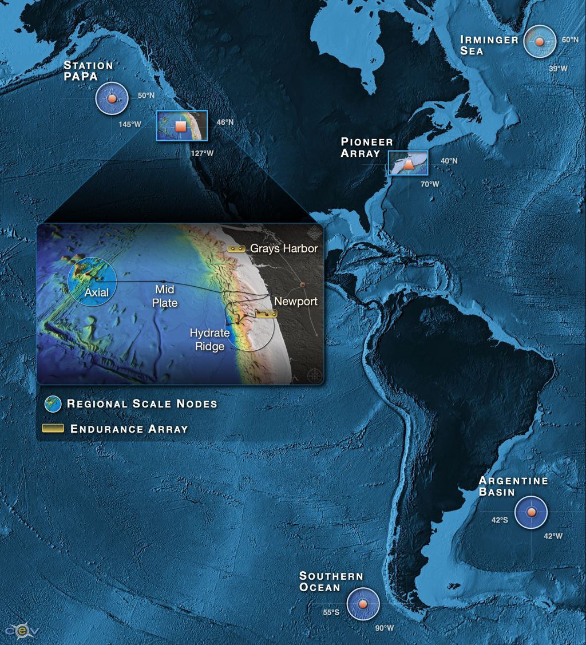
Observatory Deployment
Notes:
The marine components of the OOI are shown in the two figures above comprising the Regional Scale Nodes and Coast/Global Scale nodes.

Slide 3
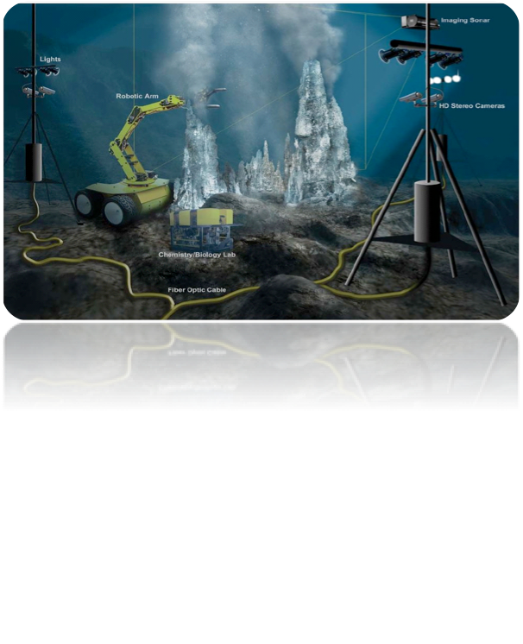
Interactive Ocean Observing
Global Interactive Federated Ocean Observatory Network
Real-time Automated Sense and Response
Command an Autonomous “Federated Network of Things”
Built over a Multi-Layer Network Strategy
Dependent on Asynchronous Reliable Messaging

Slide 4
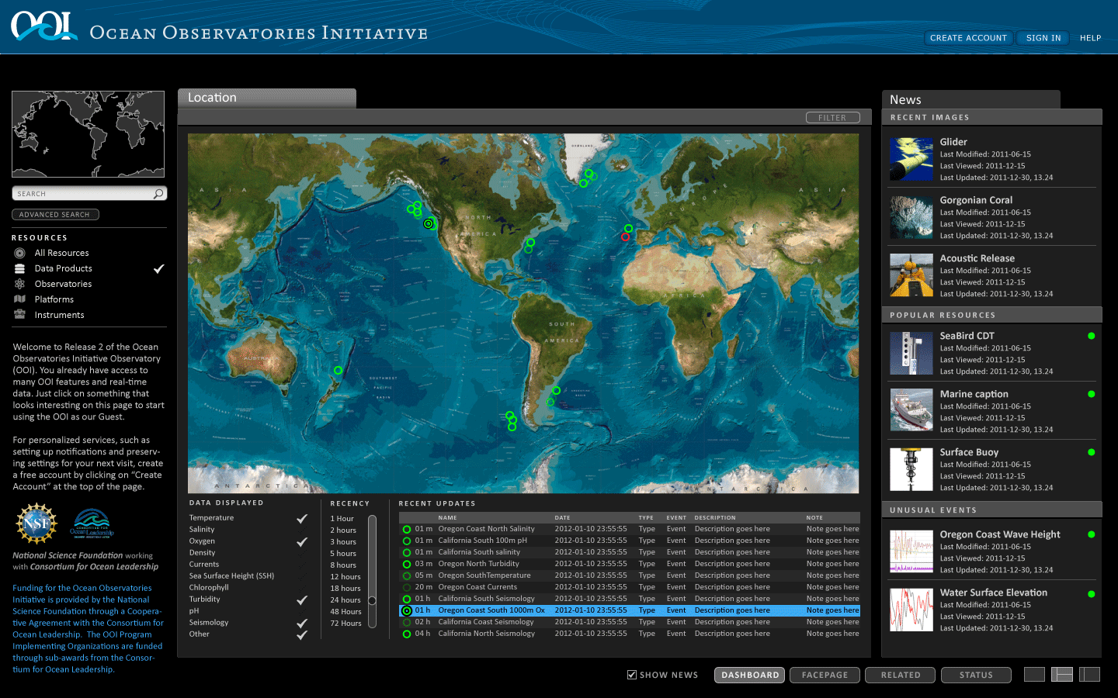
OOI Integrated Observatory Software Capability

Slide 5
Architecture Core Principles
Message Based
Service-Oriented
defined service interfaces; policy applies; message and web enabled
Managed Resources
defined resource objects and associations; resource lifecycle
Multi Domain of Authority
Interacting Agents
negotiations and commitments
Common Data and Metadata Model
Cloud Virtualization Execution

Slide 6
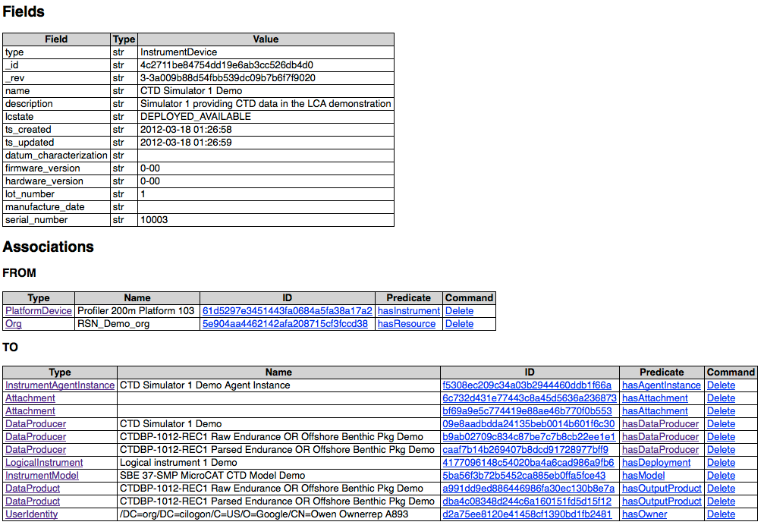
Core Principle: Resource Registry

Slide 7
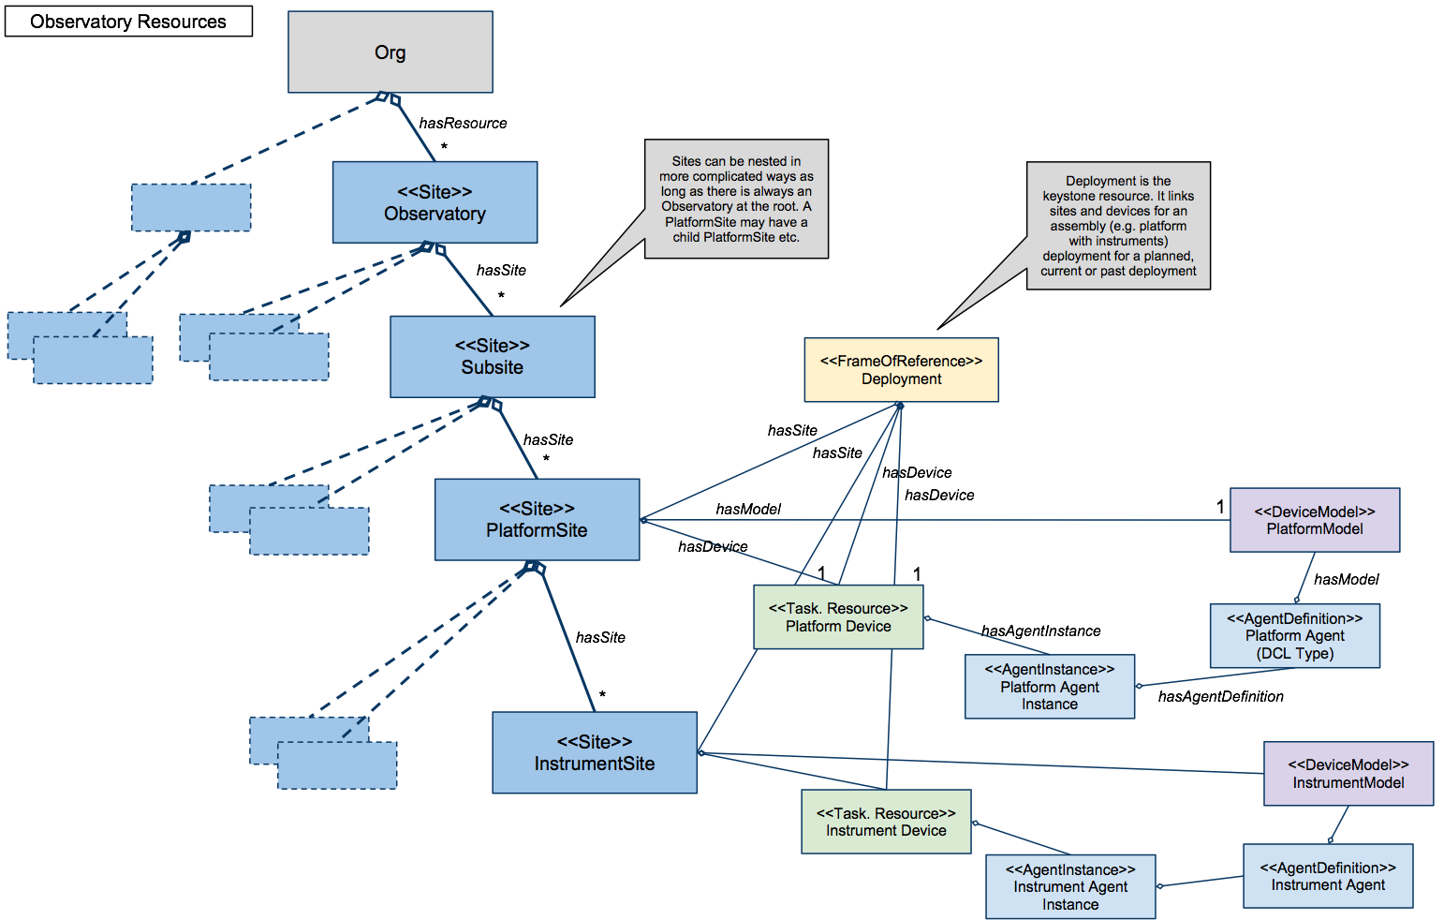
Core Principle: Resources and Associations

Slide 8
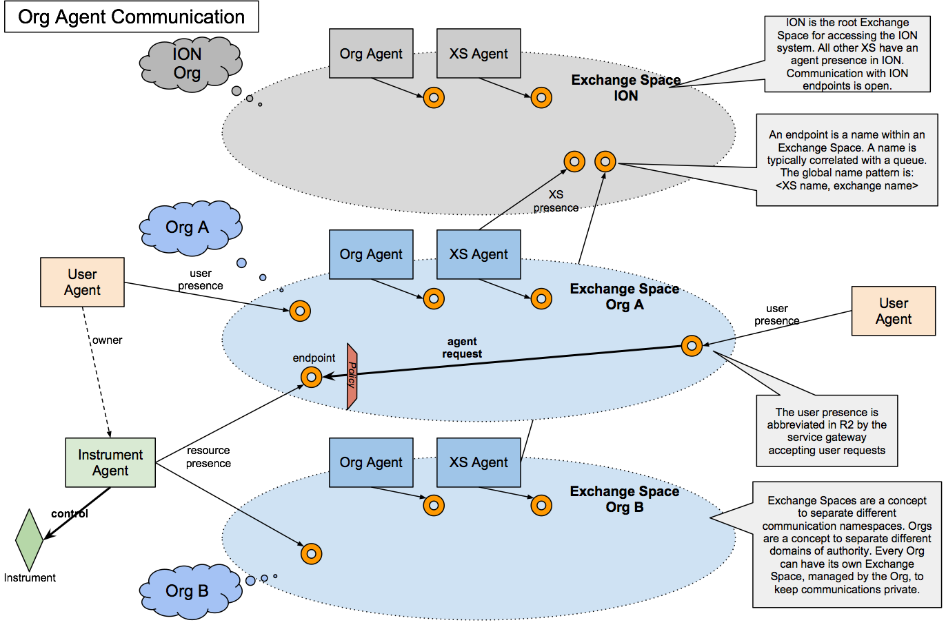
Domains of Authority, Agents and Policy

Slide 9
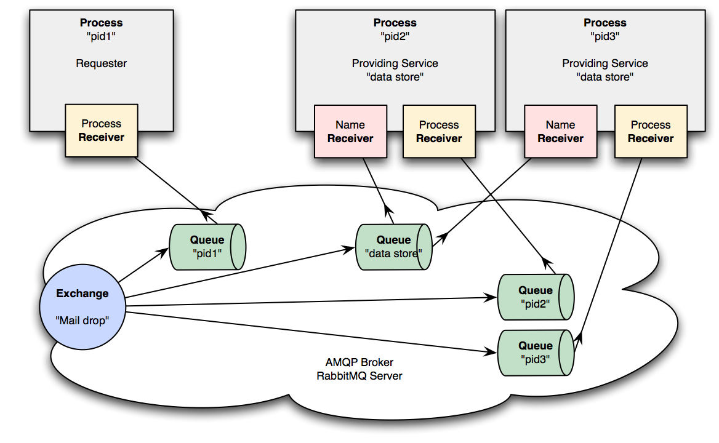
Core Principle: Distributed Processing & Communicate

Slide 10
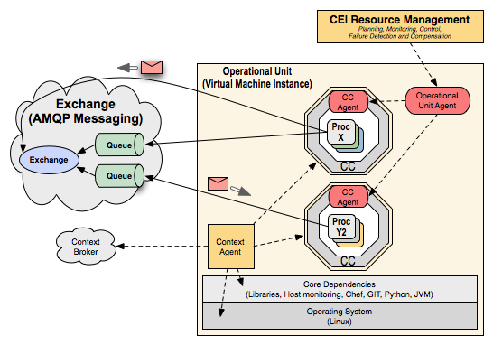
Core Principle: Capability Container and Processes
http://www.oceanobservatories.org/spaces/display/syseng/CIAD+CEI+OV

Slide 11
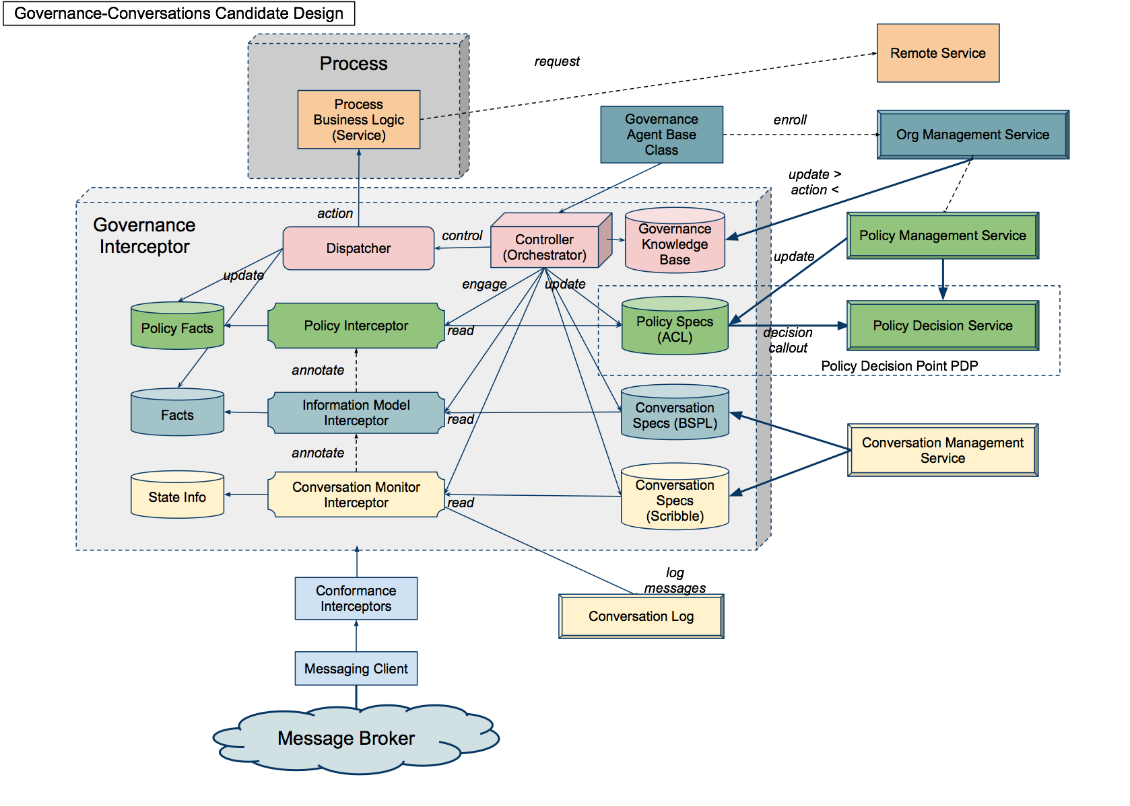
Core Principle: Business Semantics Driven Governance

Slide 12
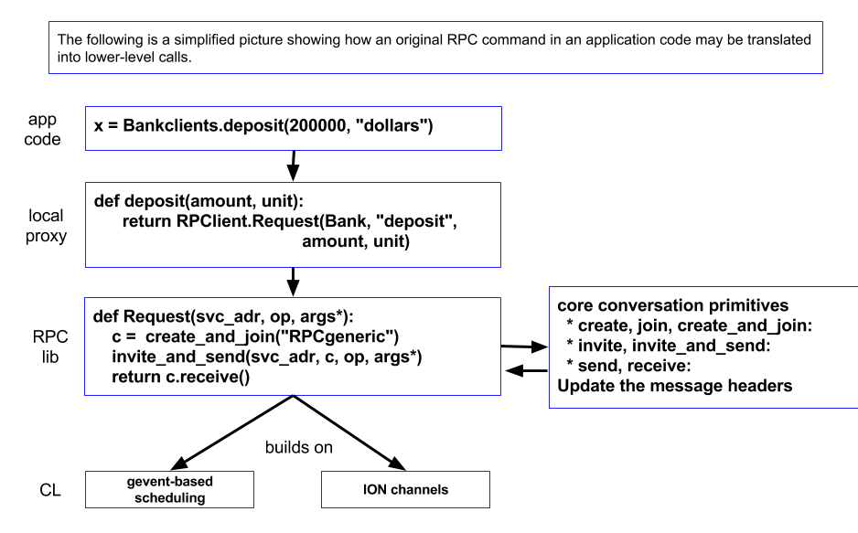
API - Current State

Slide 13
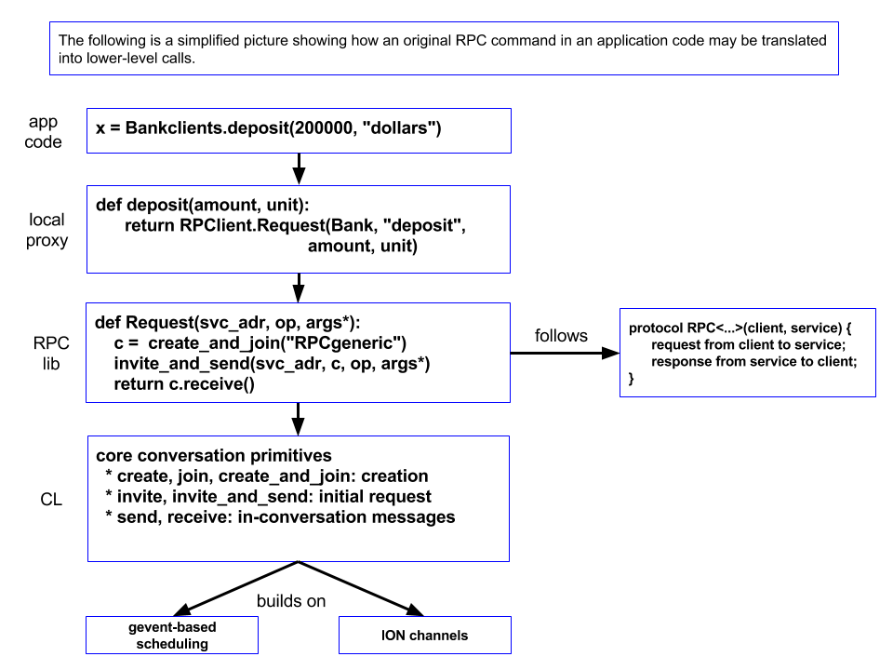
API - Target State

Slide 14
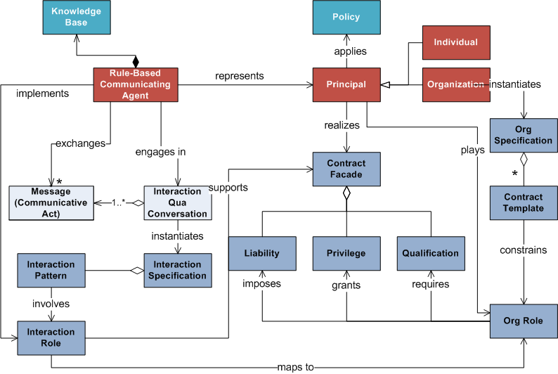
Principals, Contracts and Policy

Slide 15
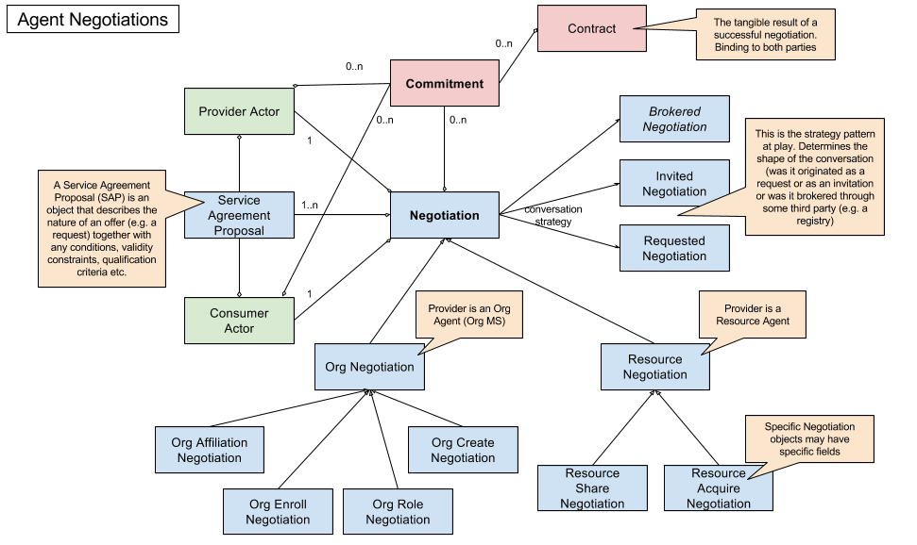
Negotiations, Commitments & Contracts
https://confluence.oceanobservatories.org/display/syseng/CIAD+COI+OV+Governance+Concepts

Slide 16
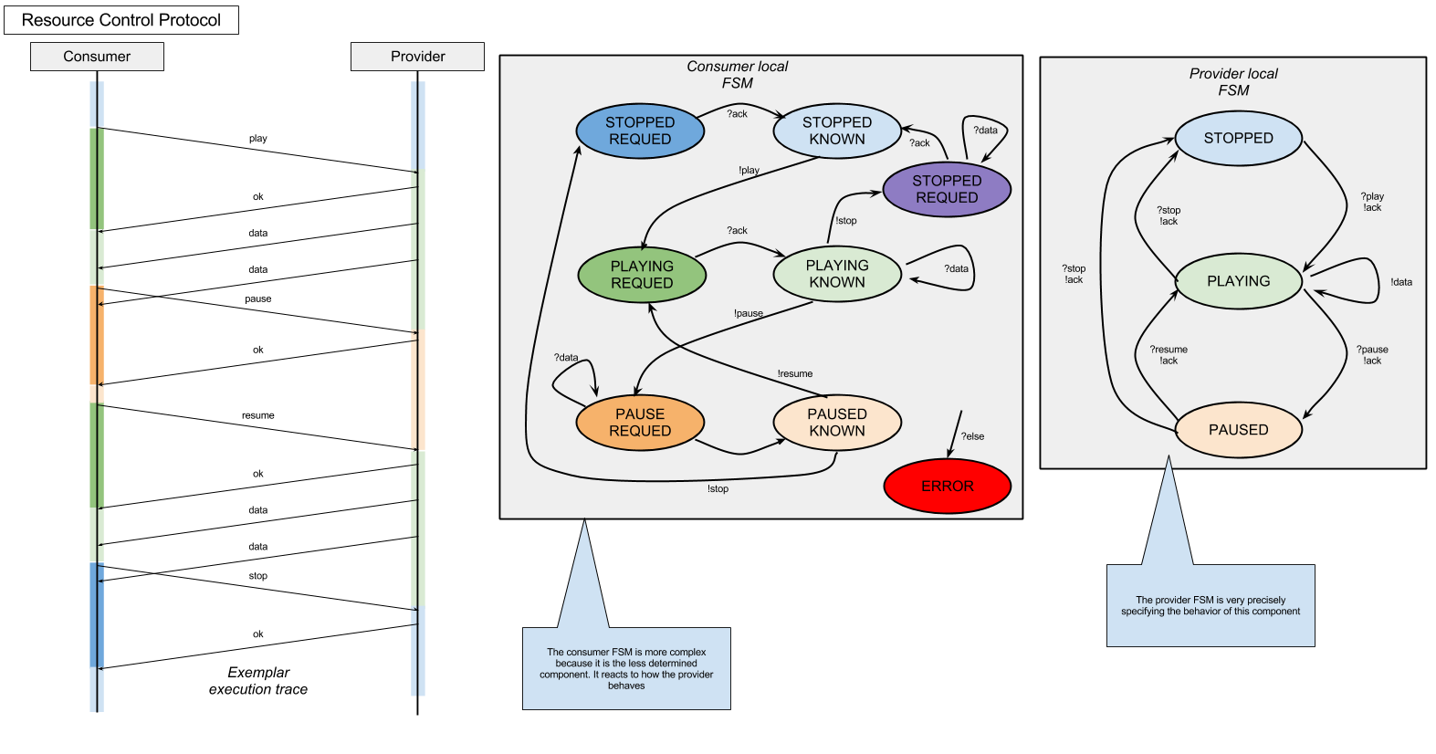
Resource Control

Slide 17
Model, View, Control Model (a monadic conversation model)
E_{in}
F
Mouse/Keyboard
Controller
E_{in}
F
Model
V₁
V₂
V₁
V₂
E_{out}
P
Viewer
P
Screen/Monitor
E_{out}

Slide 18
Conversation Model
E_{in}
F
E_{in}
F
V₁
V₂
V₁
V₂
Participant
E_{out}
P
E_{out}
P
E_{in}
F
Conversation
V₁
V₂
E_{out}
P

Slide 19
Participant Model
Conversation
Local Conversational State
Local Analytic State
Interlocutor
Interlocutor
Reasonner
Read
Write
Receive
Send
Participant

Slide 20
Deferred Binding of Information Model to Session Type
module Test;
type <java> "java.lang.String" from "rt.jar" as String;
global protocol Foo<type Y, sig X>(role A, role B, role C)
{
m1(String) from A to B;
m1(Y) from A to B;
X from A to B;
}
global protocol Bar(role A, role B, role C)
{
do Foo<String, m1(String)>(A, B, C);
}

